Slide 1

DAVI CA2 PART 2
ANALYSIS ON STUDENTS
Rejey Ezekiel Jeyakumar

Slide 2

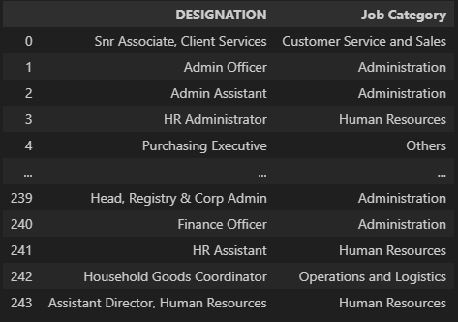
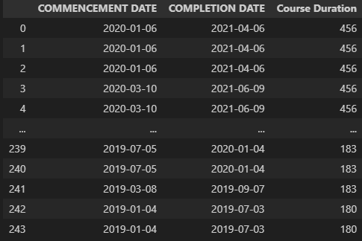
FURTHER WRANGLING
For my further wrangling i have categorized the DESIGNATION column into 10 Categories HR, admin, management, Finance, Customer Service, Operations & Logs, Marketing & PR, Education, IT and Others.
Secondly i have also added Course Duration as a column which is the difference of Course Commencement and Course Completion.

Slide 3

OBJECTIVE 2
"How can Singapore’s OX International School attract more students in the upcoming July admission period."
After looking at the data dean Mikey realized that in the end 2021 to early 2022 the school has brought in considerably less students than previous year and thus wants to figure out the profile of students to target to apply for their school in the upcoming open house and admissions period.

Slide 4

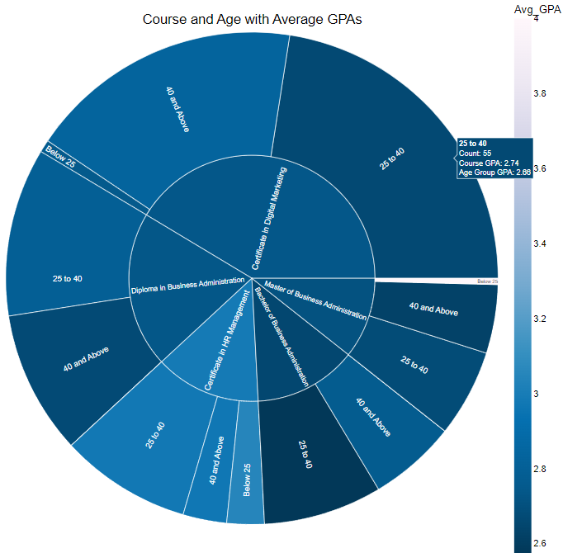
1ST PLOT
SUNBURST
This plot is shows the distribution of Course and their Age Groups, additionally we can see the average GPA of each child.
From the sunburst we can see that more than 50% of students reside in Certificate in Digital Marketing and Diploma in Business Administration, and having an average GPA of 2.74.
We can also see that students doing a Certificate in HR Management do better overall, having the highest average GPA of 2.99 and student below 25 scoring a higher end of 3.05 on average.
There is also a outlier in the Master of Buisness Administration Course where a student below 25 has a 4.0 whereas the average for that course is 2.71

Slide 5
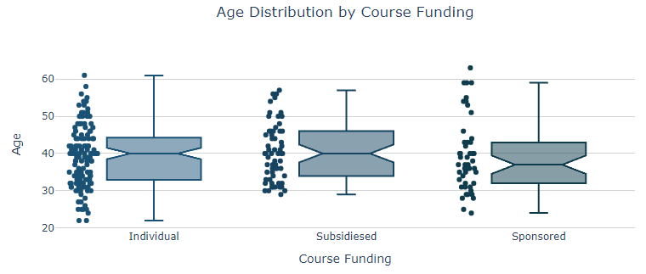
BOXPLOT
2ND PLOT
This Graph shows the Distribution of Age against course fundings for the students, as we want to know how many students are being sponsored or have subsidies.
For all 3 categories we can see that the students aged 40 are the most dense, and as for Sponsored Students age are the lowest on average. Individual and Subsidies having the same median age.
The data shows that Individual has the most students, mostly clustered from 30 - 40. For Subsidized at around 30 -35 and lastly Sponsored at 30-35 also.
There are also outliers within the 3 Funding groups most being at the higher ages, with individual having the most overall.

Slide 6
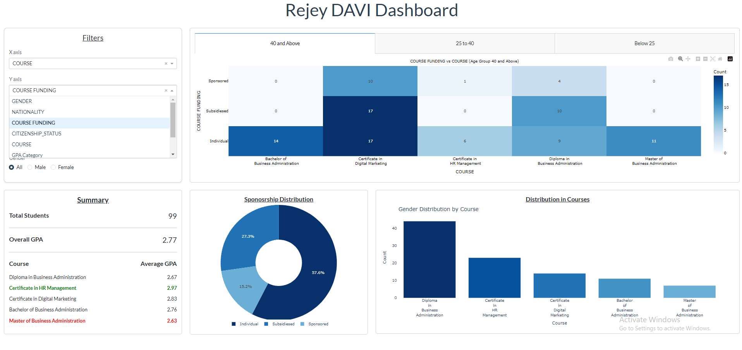
PLOTLY DASHBOARD

Slide 7
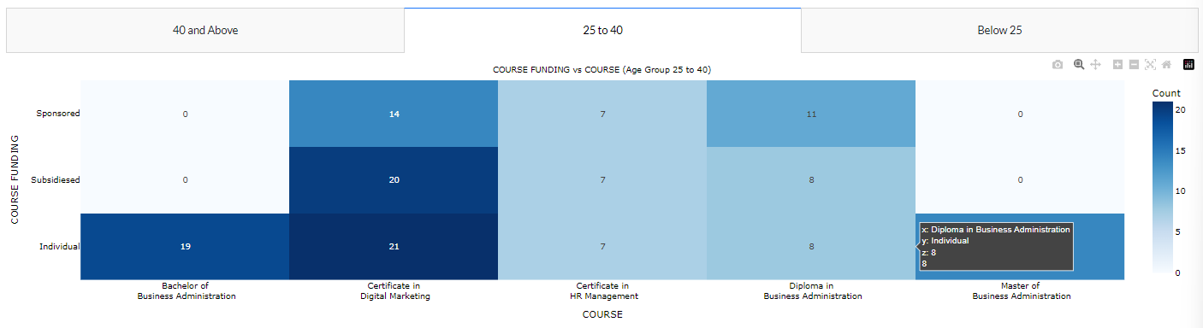
DASHBOARD INSIGHTS
Heatmap
Relationship between Course Funding and courses over Age Group 25 to 40.
From this we can see that majority of students are in the Certificate in Digital Marketing Course, at 55, and the lowest being Bachelor of Business Administration & Master of Business Administration.
From the Heatmap we can also see that that individuals have the highest overall student count in terms of funding for ages 25-40.
Showing that the most popular courses for students aged 25-40 is Certificate in Digital Marketing & the least popular is Certificate in HR Management.

Slide 8
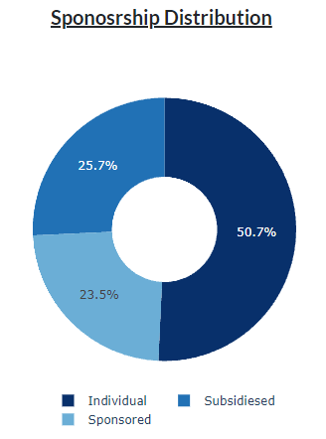
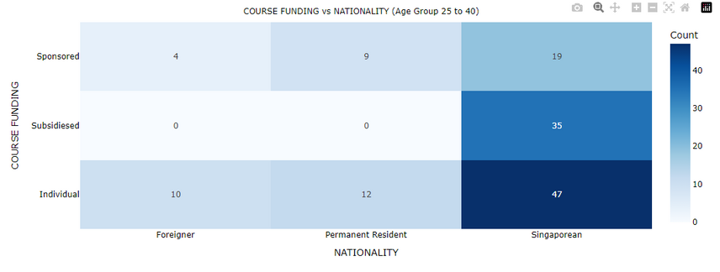
DASHBOARD INSIGHTS
Pie Chart
This graph shows the distribution of students Course Funding Ages 25 to 40.
From this we can see that majority of the students are funding the course through individual means, whilst Sponsored and Subsidized are Roughly 25% each.
From the reference to the heatmap we can understand more and that the Permanent residents and foreigners, don't apply through Subsidized and only Singaporeans do.
we can also infer that majority of students aged 25-40 are Singaporeans too.
The lowest group of students being foreigners at 14.

Slide 9
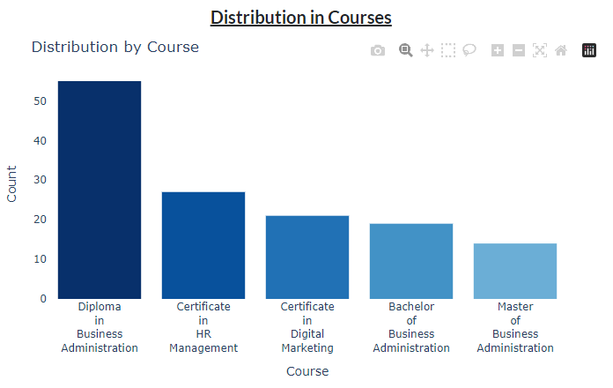
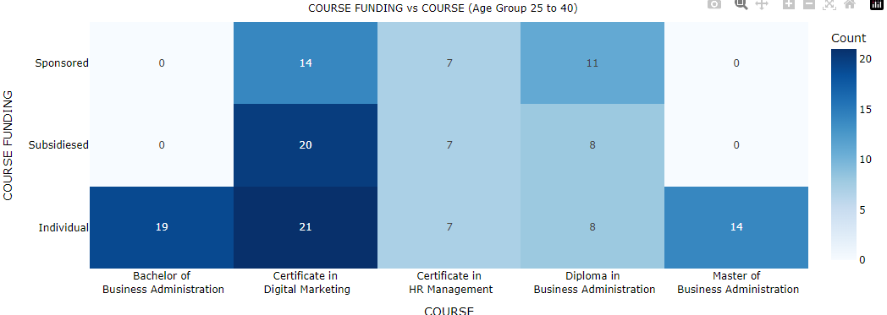
DASHBOARD INSIGHTS
Bar Chart
This graph shows the distribution of students in each course filtered by the filters,
Showing the most populated course is Diploma in Business Administration, and the lowest being Master of Business Administration & Bachelor of Business Administration. One of the reason being the SFC or Skills future credits can only be used for Undergraduate courses offered by MOE.
As we can see they don't get any subsidies or sponsors therefore leading to lesser enrollment.

Slide 10
FINAL
RECOMMENDATION
For my recommendations to dean Mikey for his the upcoming enrolment period is :
He should target students who are aged 30 - 40 years old and currently working in HR and is looking to upskill themselves.
Help get subsidies from private or MOE for Foreign and Permanent resident Student.
Try to reduce course prices for Masters & Bachelors courses as they don't allow SFC, and cost a lot. Therefore, many students don't enroll in them due to the high cost and lack of subsidies.

